Slide 1
Writing and Reviewing with AI SoSe 2026 · ZSL Heidelberg
Lesson 7
Outlining and drafting
Monday 8 June 2026 16:15–17:45
Monday 8 June 2026 · 16:15–17:45

Slide 2
Where we got to
L01. What an LLM is. Prompts, tokens, context windows.
L02. Plagiarism, paraphrase, voice. Citation styles.
L03. Genres. Topics and controlling ideas.
L04. Macro structure — IBC, IMRaD, CARS.
L05. Revision with AI.
L06. Audience, purpose, style, and flow.
Today (L07). Outlining and drafting — from topic to a working draft.

Slide 3
Today
1
What a draft is — and outlining the skeleton
2
Explore your controlling idea — questions to focus a thesis
3
A short exercise
4
Writing devices — analogy, comparison, definition…
5
The draft-o-matic — the rest of the lesson

Slide 4
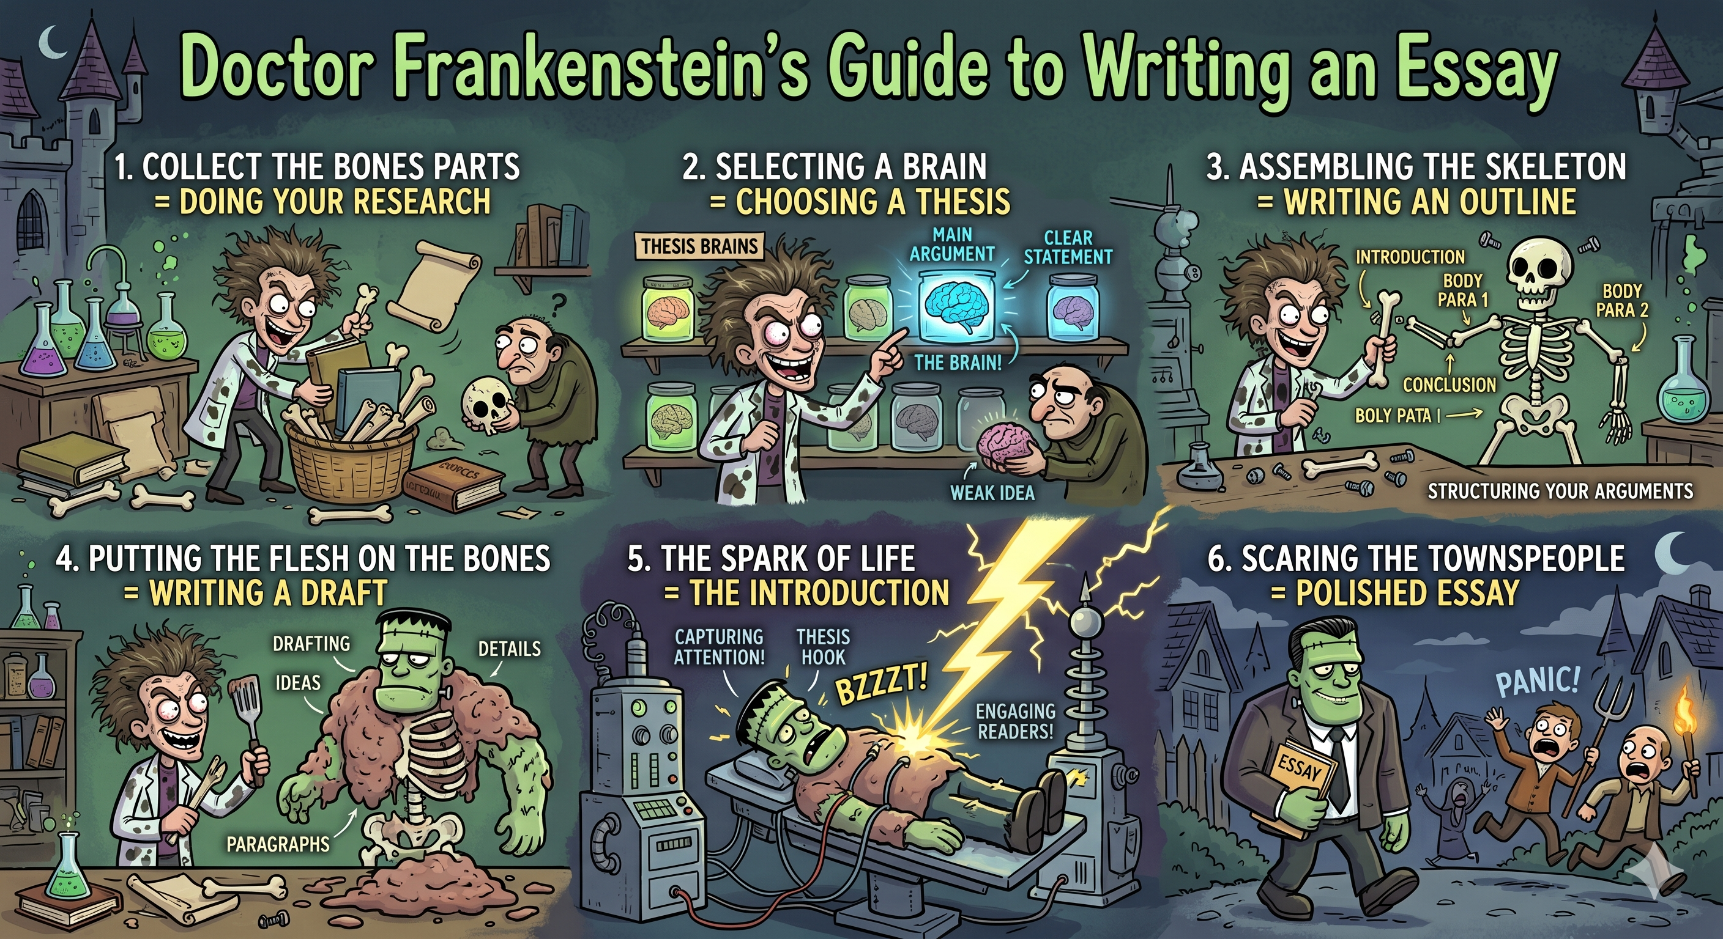
What a draft is
A draft is a work in progress — not a small finished paper.
The outline is the idea skeleton, the finished essay is the living creature, the draft is everything in between.

Slide 5
The writing process
Drafting is one stage of several:
Brainstorming · Organising · Drafting · Reviewing · Revising · Publishing
“Adequate preparation (brainstorming and organising) means that the drafting stage will go much more smoothly.”
— Zemach, Unit 1, p. 6
An agent like Claude Code can help with the organizing, but it can forget things. Keep your own TODO lists.

Slide 6
A draft is provisional by design
Sections can be empty, one line long, some bullet points or just a URL.
Arguments can be a note
Order can change.
You are deciding what to say and in what order — not yet how well.

Slide 7
Outlining — the skeleton in words
An outline is the skeleton written down before the prose.
A textual outline does this in plain sentences:
“The plan of this paper is as follows. Section II describes the current arrangements… In Section III a theoretical model is constructed… Finally, Section V offers some suggestions…”
— Swales & Feak, p. 361 (student example)
If you can write the outline, you know the shape. The draft fills it in.

Slide 8
Explore your controlling idea
Before you draft, focus the thesis by asking yourself questions.
We collect these from three sources you have already read.
The aim: move from a topic (eg “sugar”) to a single, arguable issue (eg “over-consumption of refined sugar harms college students”).

Slide 9
Questions — from Swales & Feak (CARS)
Probe the move you are making for your reader:
Centrality
Why does this topic matter? (Move 1)
The gap
What is missing or unresolved in what has been said? (Move 2)
Your contribution
What will you add? (Move 3)
A focused thesis usually answers the gap question.
Swales & Feak, Unit 1 (CARS model).

Slide 10
Questions — from Zemach (planning)
Self-prompts to scope the task:
Why are you writing this? What is its purpose?
What will be the easiest part? The most challenging part?
What will you do first? Then what steps will you follow?
How much time will it take you?
Scoping is a disguised narrowing question.
Zemach, Unit 1, p. 4 (Discussion 1).

Slide 11
Questions — from Lester (the introduction)
Turn a topic into a controlling idea:
Subject — can you narrow it to one issue?
Background — what does your reader already know, and need?
Problem — what is the complication you want to explore or resolve?
Thesis form — a statement, an enthymeme (a because claim), or a hypothesis?
“The point of a research paper is to explore or resolve a problem.”
Lester & Lester, 16th ed., §12a.

Slide 12
EXERCISE
Narrow it.
Take this topic: “social media” . In three minutes, write it down and narrow it using the questions:
1
One issue — which aspect?
2
The problem — what complication?
3
Thesis form — statement, enthymeme, or hypothesis?
Compare with a neighbour. Whose is narrower?

Slide 13
Writing devices
Once you have a controlling idea, you develop it in the body.
These are methods of development — ways to turn a claim into a paragraph.
A draft note can simply say which device a paragraph will use.
Lester & Lester, 16th ed., §12b.

Slide 14
Writing devices — definitions (1)
Device
What it does
Analogy
Explains the unfamiliar by likening it to the familiar.
Comparison / contrast
Sets the idea against something it resembles or differs from.
Cause and effect
Traces why something happens or what follows from it.
Definition
Pins down a key term before building on it.
Classification
Breaks the subject into types or parts, taken in turn.
Example / evidence
Supports the claim with a concrete instance or data.
Citation / authority
Brings in a source to back or complicate the claim.
Chronology
Give some history of the topic

Slide 15
THE DRAFT-O-MATIC
A guided tool to take you from topic → controlling idea → structure .
We will spend the rest of the lesson here.
dev.zsl-13.boldra.com/l7/draft

Slide 16
Now we will write a draft with the draft-o-matic

Slide 17
That's it.
Thank you.
See you next Monday — L08: Grammar, structures and punctuation.

