Slide 1
Lesson 4
Structure: introductions and conclusions
Monday 11 May 2026 · 16:15–17:45

Slide 2
Where we got to
L01. What an LLM is. Prompts, tokens, context windows.
L02. Plagiarism, paraphrase, voice. Citation styles. Five paraphrase criteria.
L03. Genres (essay, case study, lit review, report, proposal). Topics and controlling ideas - thesis, enthymeme, hypothesis.
Today (L04). We put a structure around the controlling idea.
Homework due: Gap-fill 1 was due before the lesson

Slide 3
Today
  Macro structure - IBC and IMRaD
  Section names
  Exercise 1 structure elements
  Headings
  Conclusions - what to include, what to avoid
  Flow
  Introductions - CARS
  Exercise 2 - Eakins essay
  Exercise 3 - write your own introduction

Slide 4
Macro vs micro
Macro structure - how the parts of a paper fit together (intro, body, conclusion).
Micro structure - how sentences and paragraphs fit together (flow, cohesion, transitions).
Today is mostly macro. Micro comes back in L09 and more.

Slide 5
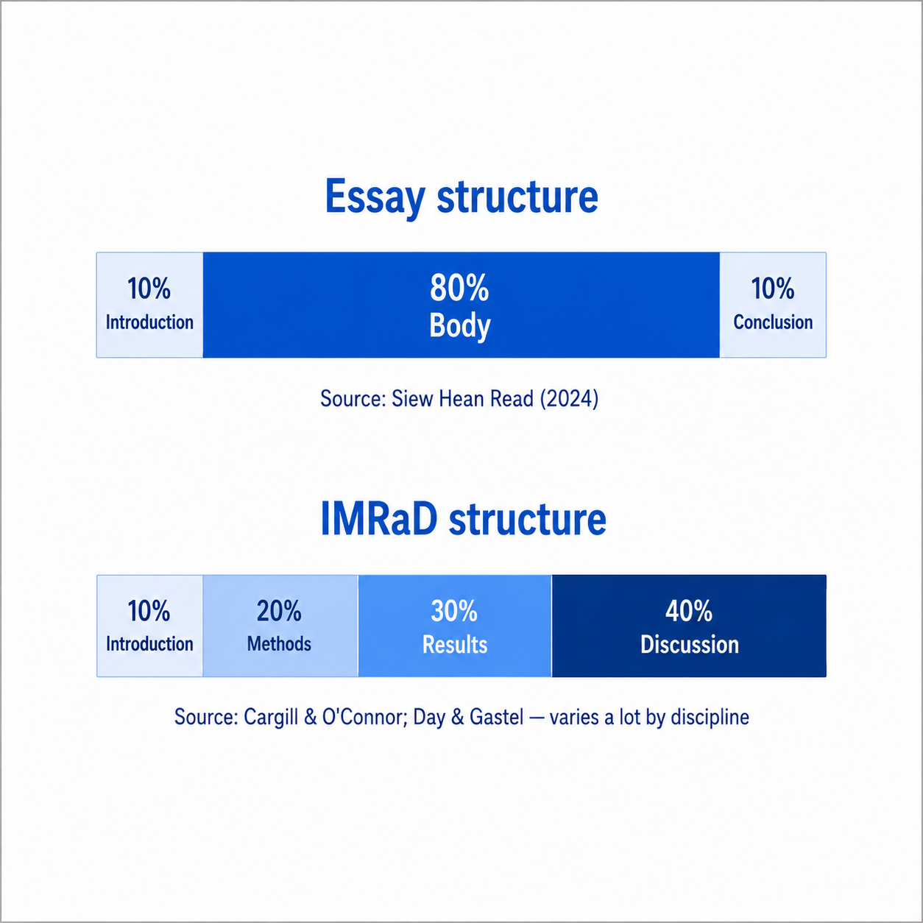
IBC vs IMRaD - proportions

Slide 6
What each part does
Part of paper | Job
Introduction | Establishes the problem
Body / Method + Results | Presents the evidence
Conclusion / Discussion | Answers, judgements, closure
Same three jobs in both frames. IMRaD just splits the body in two and renames the closure.

Slide 7
Section name synonyms
Function | You may see it called
Open the paper | Introduction · Background · Overview · Abstract · Executive summary
Show the work | Body · Method · Materials · Procedure · Results · Findings · Analysis
Close the paper | Conclusion · Discussion · Implications · Outlook · Recommendations

Slide 8
Results · Discussion · Conclusion
 | What it does
Results | Factual statements and their interpretation
Discussion | The claims that might be made - especially new-knowledge claims
Conclusion | Closes the paper. Looks back, sometimes forward
The difference between Discussion and Conclusion is partly conventional, depending on field and journal. - paraphrased from Swales & Feak, p. 365

Slide 9

Exercises 1 + 2
zsl-13.boldra.com/l4

Slide 10
Headings
When to use them:
IMRaD papers and reports - always.
Essays - sparingly, only when sections are long enough to need them.
Use parallel phrasing - keep all H2s in the same grammatical form (all noun phrases, or all questions, etc.).

Slide 11
Conclusions - must include
Lester’s positive checklist:
  Restate the thesis - in different words, not as a copy-paste.
  Summarise the main points or evidence.
  Reach beyond - implications, future work, what now.
  Closure - the reader knows the essay is finished.
Lester (16th edn) §12c.

Slide 12
Conclusions - must avoid
Lester’s negative checklist:
  New arguments or new evidence.
  New sources.
  Apologies or self-doubt.
  Pure summary with no judgement.
  “In conclusion, …” as your only signal of closure.
Lester (16th edn) §12c.

Slide 13
Discussion sections - five stages
For IMRaD discussions specifically:
  Background information (optional)
  Summarising the findings
  Commenting - claims, explanations, comparisons
  Limitations (optional)
  Recommendations
Swales & Feak, p. 368, fig. 18.

Slide 14
“The beginning is half of the whole.”
- Plato

Slide 15
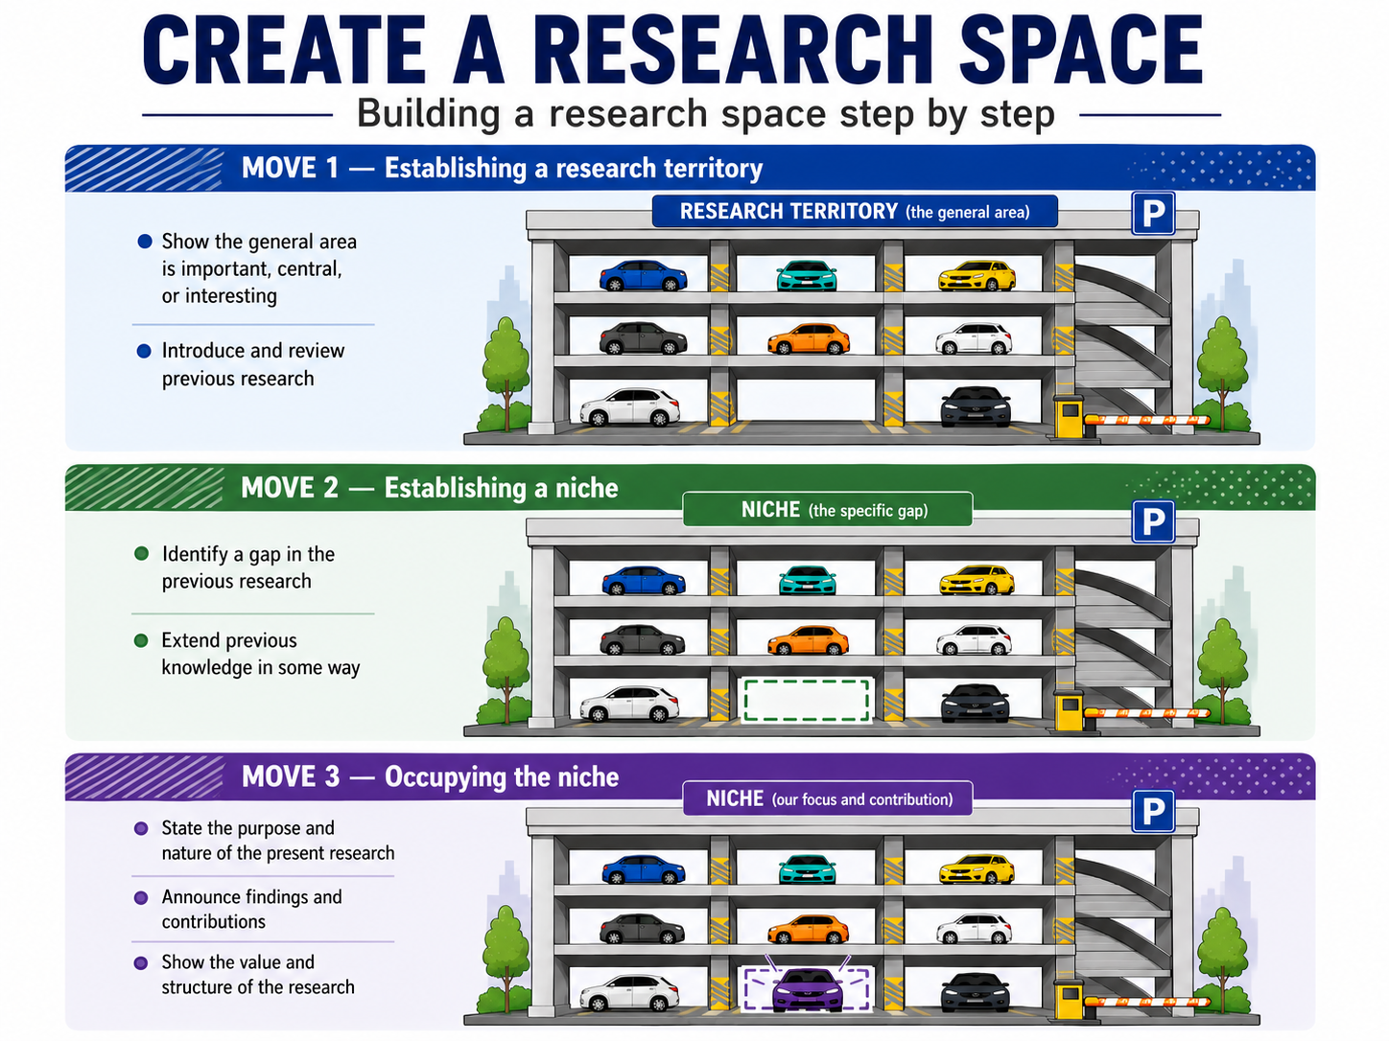

Slide 16
John’s Eakins introduction
Read the handout and look at the questions

Slide 17
Solutions - three moves in John’s Eakins
Q1 - three moves - Move 1 (territory): sentences 1–9 - Move 2 (niche): sentence 10 - Move 3 (occupy): sentences 11–12
Q2 - paragraph breaks - natural breaks after sentence 6 and sentence 9 (three paragraphs).
Q3 - Move 1a / 1b - 1a centrality: sentences 1–2. 1b literature: sentences 3–6.
Q4 - Move 2 type - counter to an existing simple explanation.
Q5 - Move 3a type - announcement of present research (“in this paper I will argue …”).
Q7 - citations - three (footnote 1, Foster 1997, Johns 1983).

Slide 18
Lester’s alternative frame
Lester | CARS equivalent
Subject | (sets up territory)
Background | Move 1 - territory
Problem | Move 2 - niche
Thesis | Move 3 - occupy
Same idea, different vocabulary. Use whichever fits your field.
Lester (16th edn)

Slide 19
Introductions - must include
From Lester’s positive checklist:
  Subject - name and narrow the topic.
  Background - relevant context,
  Problem - explain why it’s complicated.
  Controlling Idea - Thesis, enthymeme or hypothesis.

Slide 20
Introductions - must avoid
"The purpose of this study is …" (except in APA empirical reports)
Repetition of the title.
Complex language
Simple dictionary definitions
Humour and drawings

Slide 21
Exercise 3, writing introductions
https://zsl-13.boldra.com/l4

Slide 22
- No class **25 May** - Pentecost break.
- **Assignment 1** (Gap-fill 1) - was due today.
- **Assignment 2** (Structure exercise, 600 words polished intro + conclusion) - due **May 25th** (email only - no class)
- Researching with AI next week
- Questions?
---
# That's it
Thank you.
See you next Monday.

